Slide 1
COMP1003
Lab 02 Logic Gate
Goliath

Slide 2
Example 1
Lecture 02 has introduced the NOT gate and the NOR gate.
In this lab, all other gates are implemented by these two.
First, please observe the behavior of NOT and NOR in Digital.
You can find these two components under “Logic” category.
Please remember to place “Input” and “Output” components in your circuits.

Slide 3
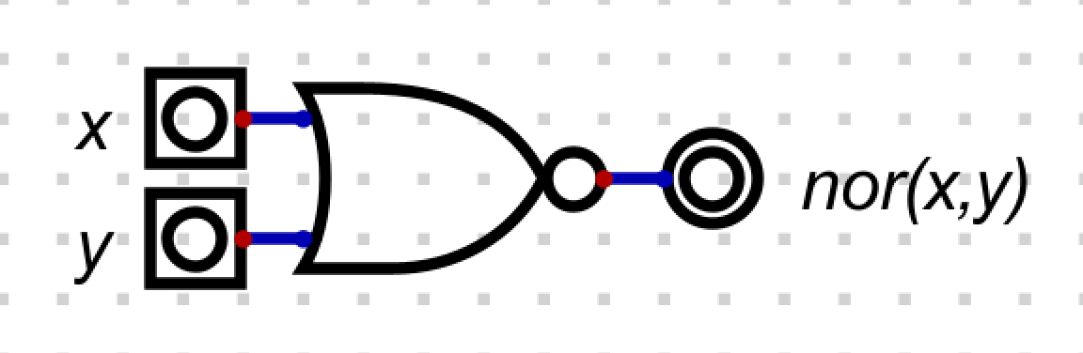

Example 1
NOR
NOT

Slide 4
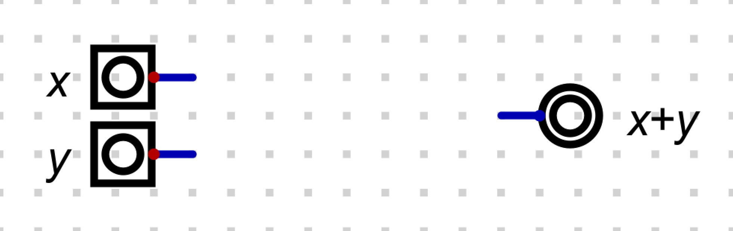
Example 2
Implement an OR gate by using NOT and NOR.
Inputs and the output are given as follows.

Slide 5
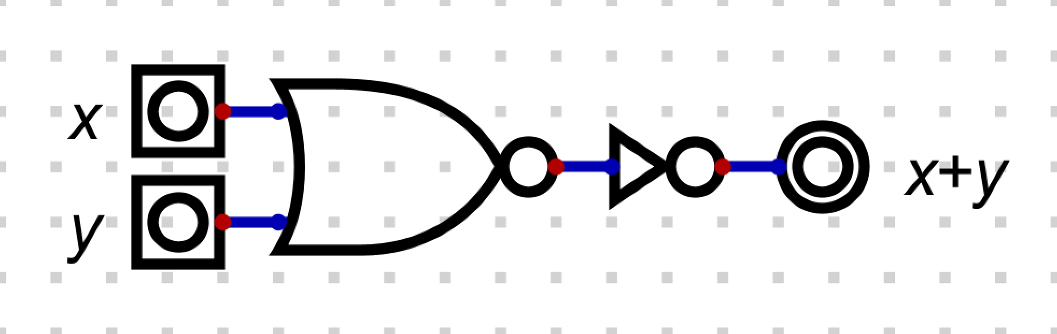
Example 2
Is the following implementation correct? How do you know?
Of course one can start a simulation and play with the inputs.
But that is not efficient.

Slide 6
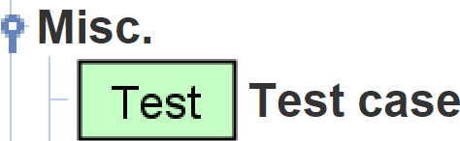
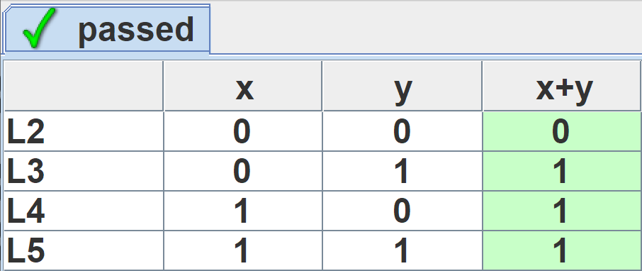
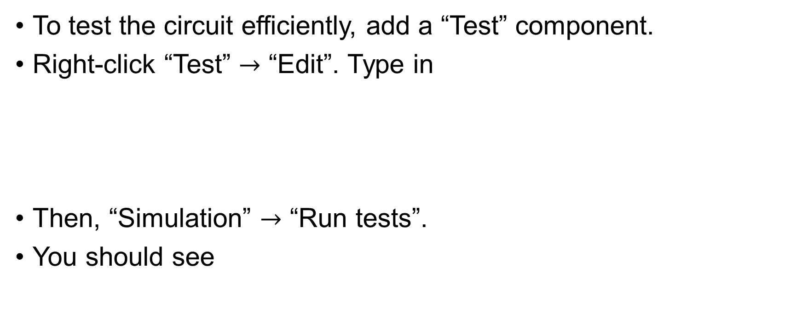
Example 3
To test the circuit efficiently, add a “Test” component.
Right-click “Test” $→$ “Edit”. Type in
Then, “Simulation” $→$ “Run tests”.
You should see
x y x+y
0 0 0
0 1 1
1 0 1
1 1 1

Slide 7
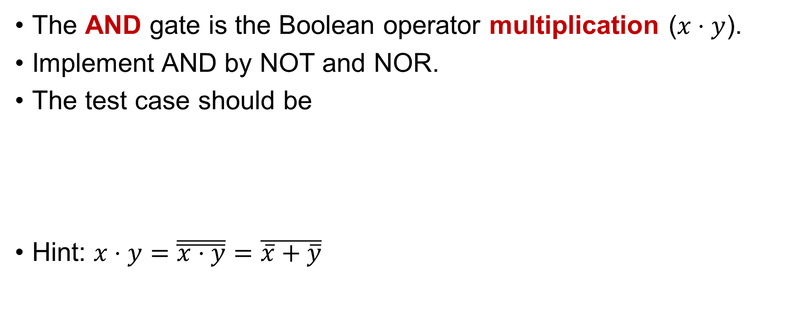
Example 4
The AND gate is the Boolean operator multiplication ($x⋅y$).
Implement AND by NOT and NOR.
The test case should be
Hint: $x⋅y=\overline{\overline{x⋅y}}=\overline{\overline{x}+\overline{y}}$
x y x*y
0 0 0
0 1 0
1 0 0
1 1 1

Slide 8
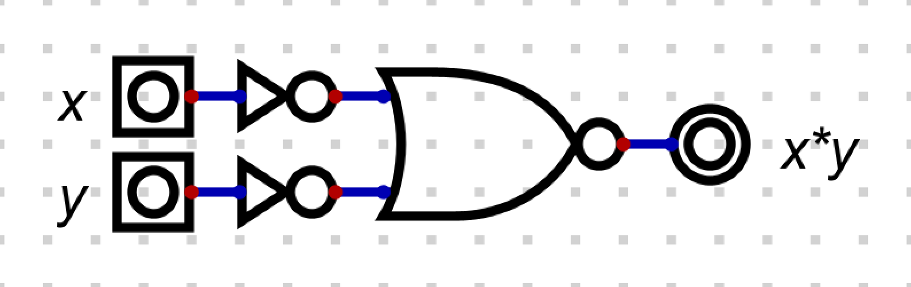
Example 4

Slide 9






Example 5
Once OR and AND are implemented, you are allowed to use them in the following examples.
OR gate:
AND gate:
$$x$$
$$x+y$$
$$y$$
$$x$$
$$x∙y$$
$$y$$

Slide 10

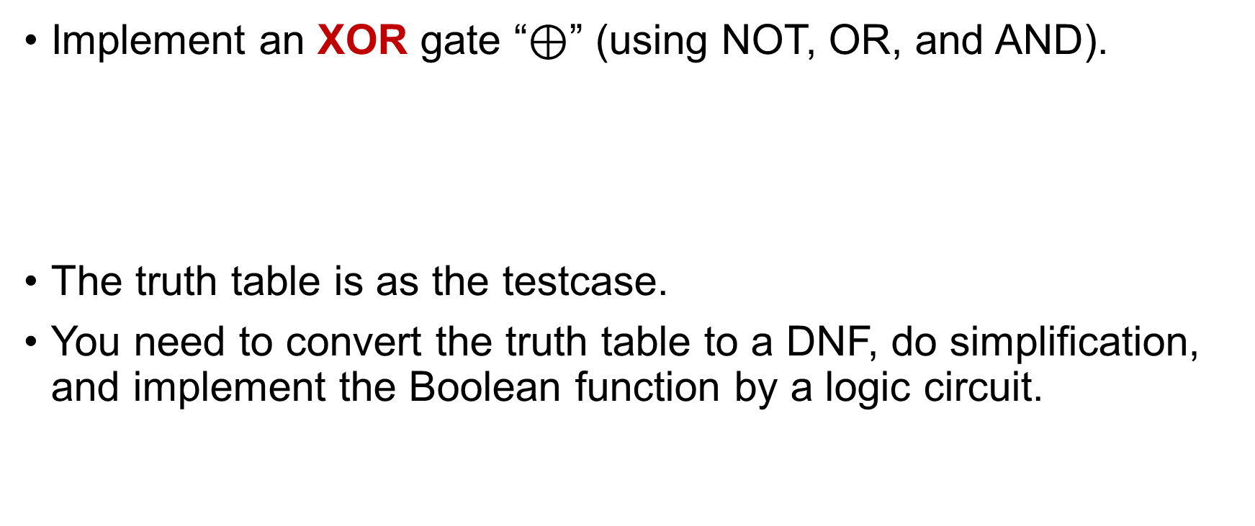


Example 5
Implement an XOR gate “$⊕$” (using NOT, OR, and AND).
The truth table is as the testcase.
You need to convert the truth table to a DNF, do simplification, and implement the Boolean function by a logic circuit.
x y x(xor)y
0 0 0
0 1 1
1 0 1
1 1 0
$$x$$
$$x⊕y$$
$$y$$

Slide 11
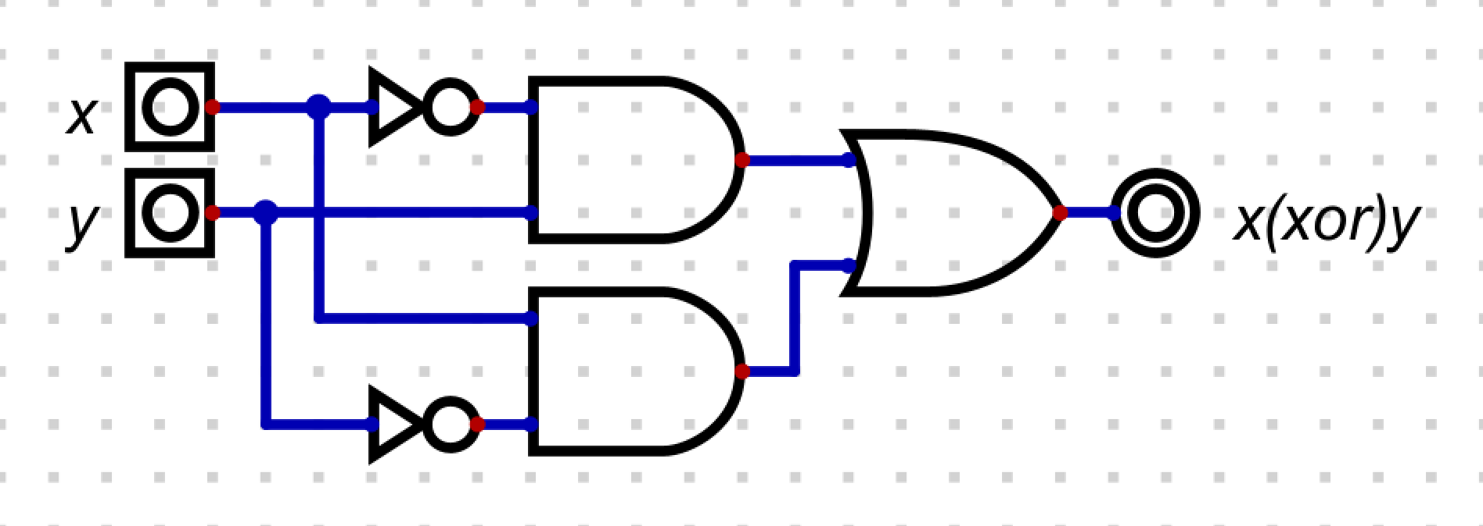
Example 5

Slide 12
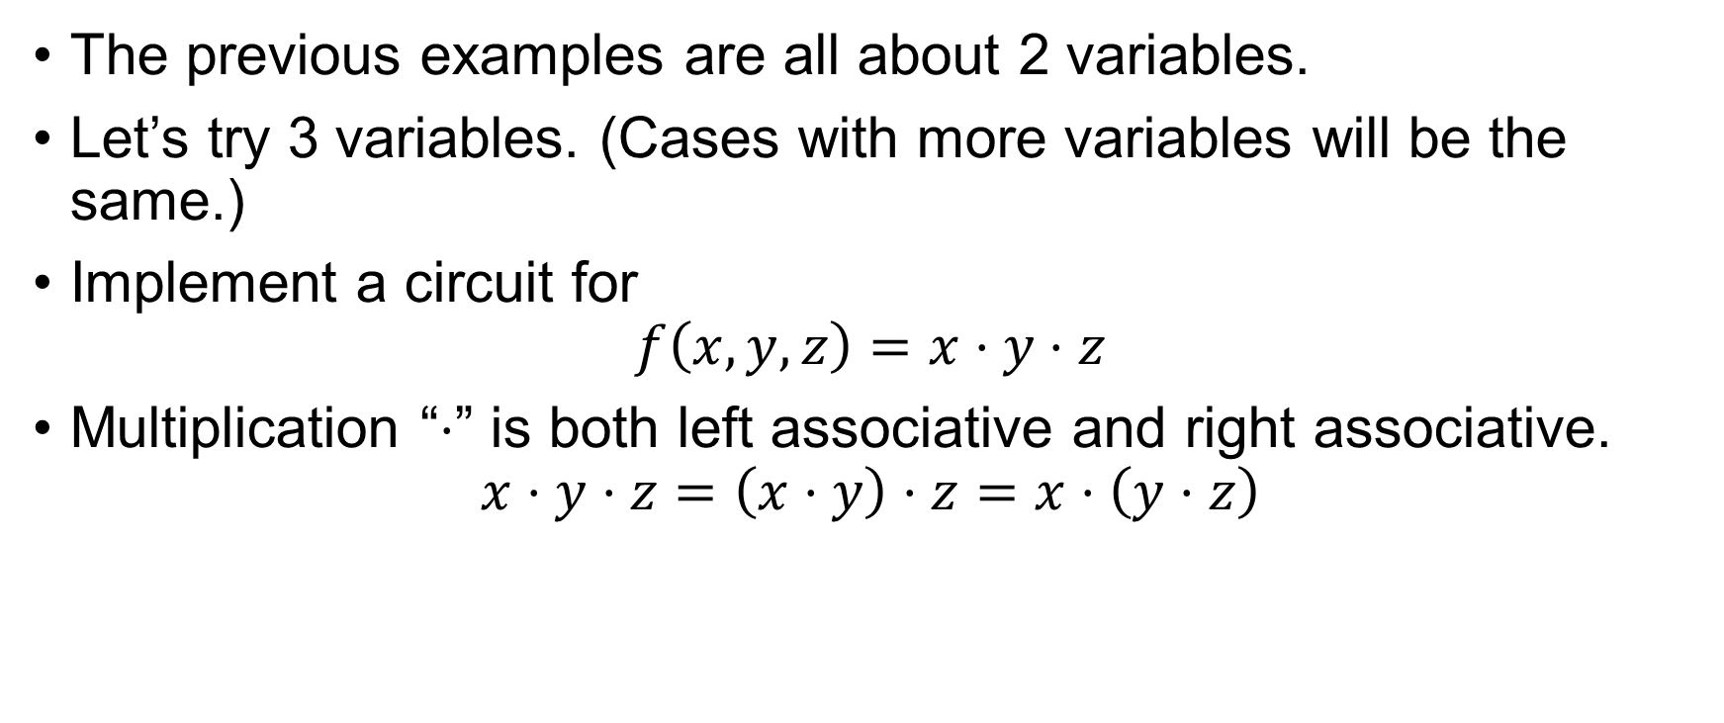
Example 6
The previous examples are all about 2 variables.
Let’s try 3 variables. (Cases with more variables will be the same.)
Implement a circuit for
$$f\left(x,y,z\right)=x⋅y⋅z$$
Multiplication “$⋅$” is both left associative and right associative.
$$x⋅y⋅z=\left(x⋅y\right)⋅z=x⋅\left(y⋅z\right)$$

Slide 13
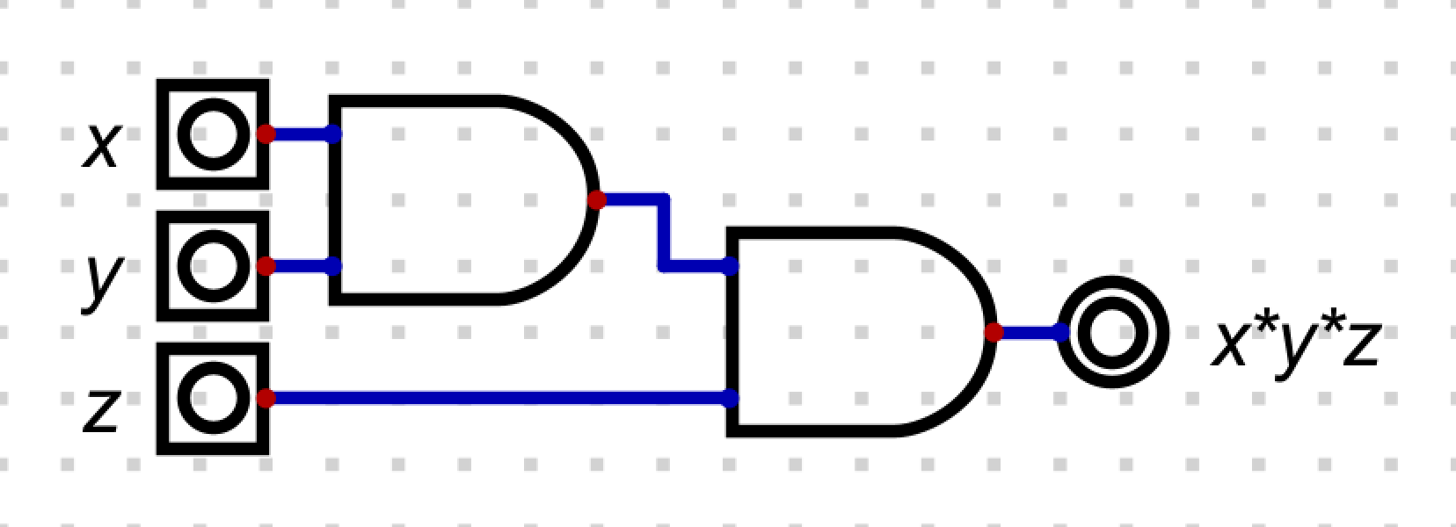
Example 6

Slide 14
Exercise 1
Implement a logic circuit for the following truth table.
Remember to simplify the Boolean function by Karnaugh map.
Also label the inputs and the output as the truth table.
x y z out
0 0 0 0
0 0 1 0
0 1 0 1
0 1 1 0
1 0 0 1
1 0 1 0
1 1 0 1
1 1 1 0

Slide 15
Submission
Save the circuit for Exercise 1 as “lab02_sub.dig”.
Submit this file to iSpace.
No marks will be given if the file name is wrong.

Slide 16
End of Lab 02

